Slide 1
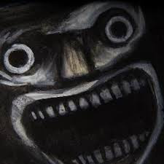
Fear – a practitioners perspective
Ben Charters – Fear Practitioner
Notes:
Intro to me and shock
Debrief fear – fight flight etc response – you now have about adrenal glands epiniphreneetc etc
Need solid (funny story)
Peronally related
Something unique and removed from the caveman fight flight well known stuff
Enhance with lesser known but significant for pilots effects like memory say or smooth muscle relaxation tie this into technical skills
Lead this into discussion of simulator training for random injects – not assesed = research these a lot

Slide 4
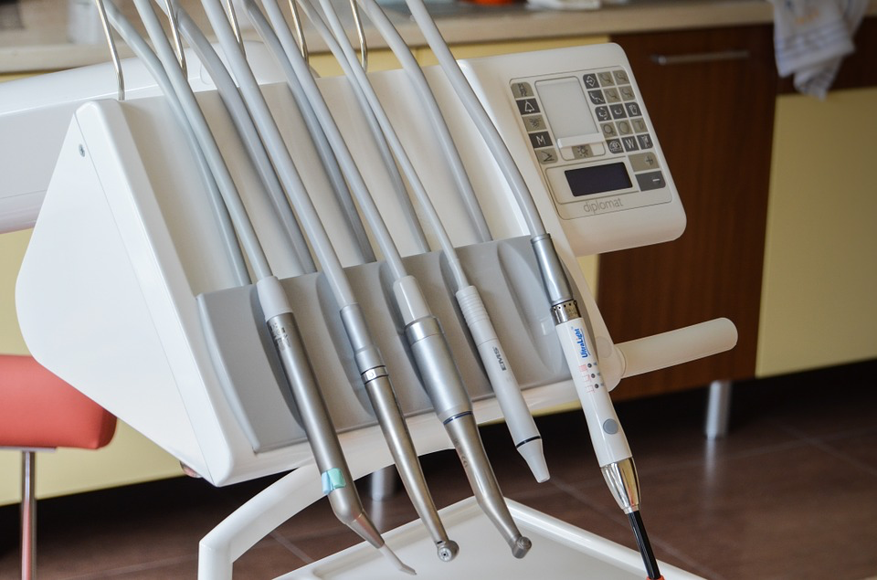
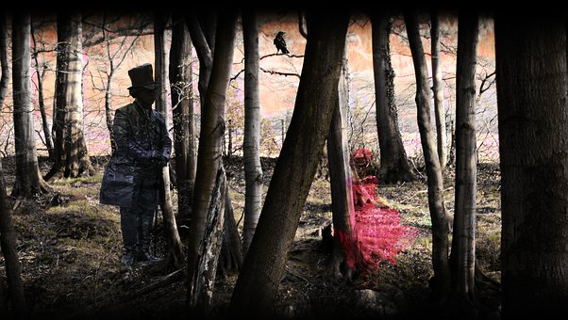
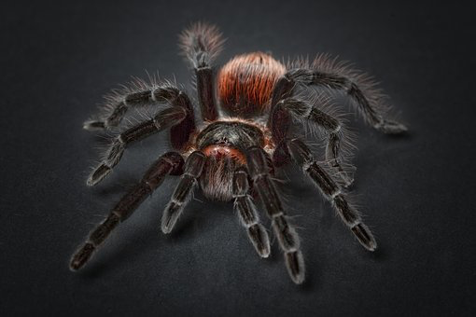
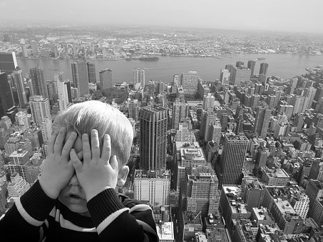
FEAR
FEAR
Notes:
How to combat adrenalin rush – good luck
Check this out http://www.wikihow.com/Control-an-Adrenaline-Rush

Slide 5
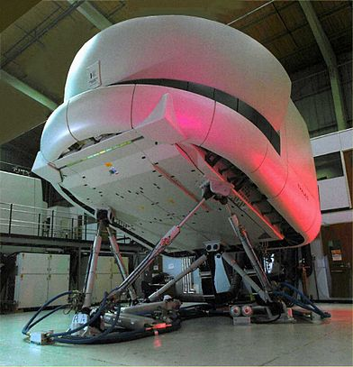
FAIL

Slide 6
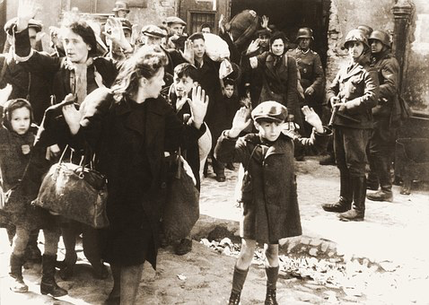
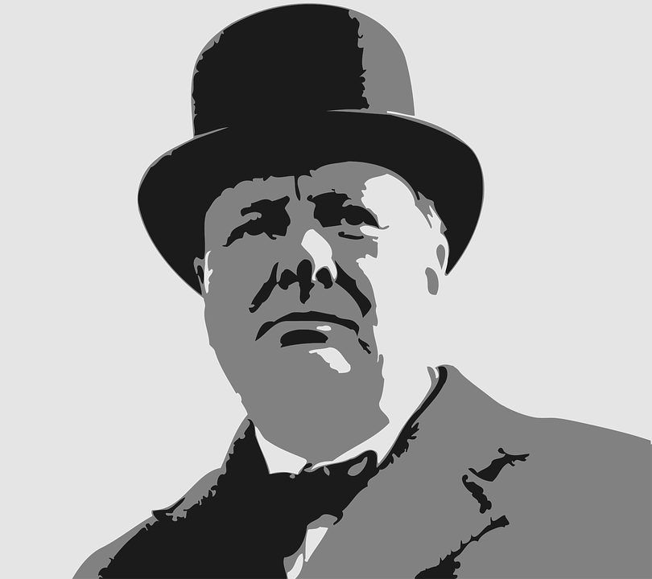

Slide 9
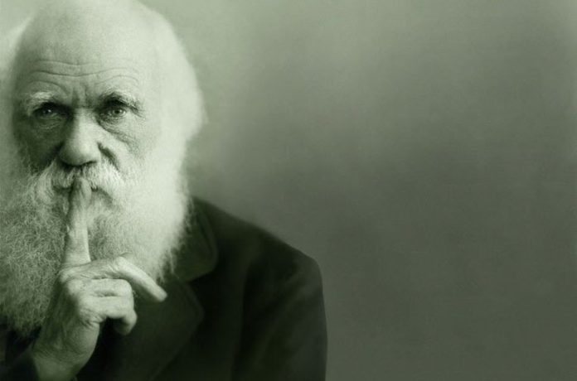
“It is not the strongest of the species that survives, nor the most intelligent that survives. It is the one that is the most adaptable to change.” – Charles Darwin

Slide 10
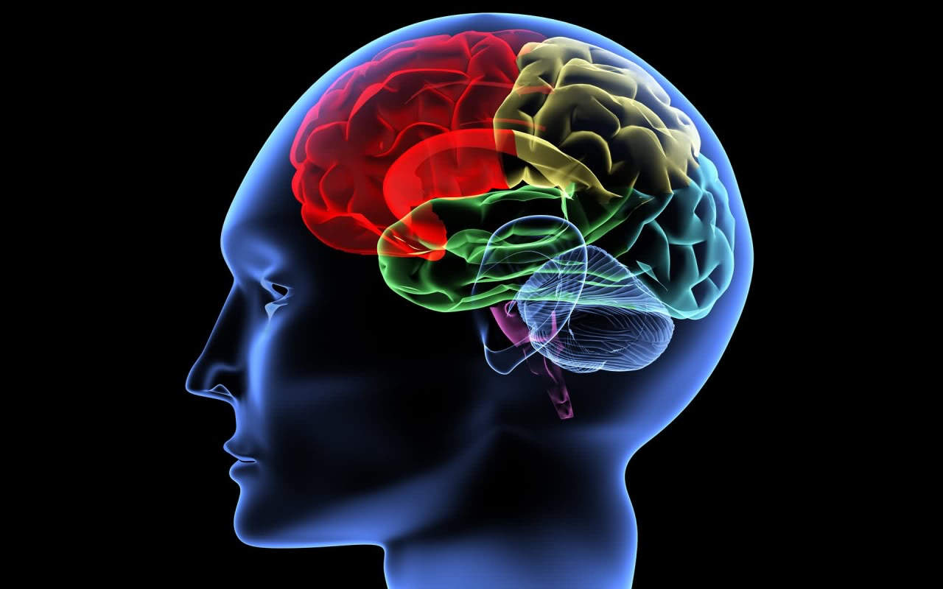

Slide 12
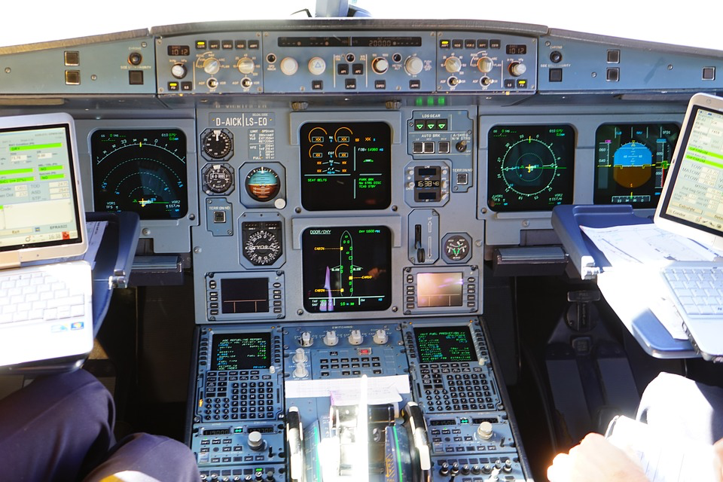
Here’s what I remember – hope it helps…….
Cheers Mike
SIM 1
Day 1
First up is a LOFT ride from Brisbane to Accupulco with a depressurisation followed by coffee machine failure/
2. Captains LHS inverted flame out TACAN followed by FO half pike and twist.
3. Both pilots will get marked on their triple axle and general stage presence as well as some HF crap but didn't’t pay much attention to that……
4. Finally we got a Galaxy note 7 fire followed by an emergency evac, half roll and pull through with an immelman to finish.
Good luck…..M
Sim Session 1 “Gouge Guide”
By Frank Furter
Day 1.
Students will be expected to perform everything better than the check captains.
Day 1 starts with multiple malfunctions followed by intensive instrument flight.
Under instrument conditions students will be assessed on their
Ability to hiold a tune.
2. Rhythm and groove ability.
3. Being a hep muso.
4. Correct beret wearing position.
SIM Session #1

Slide 13
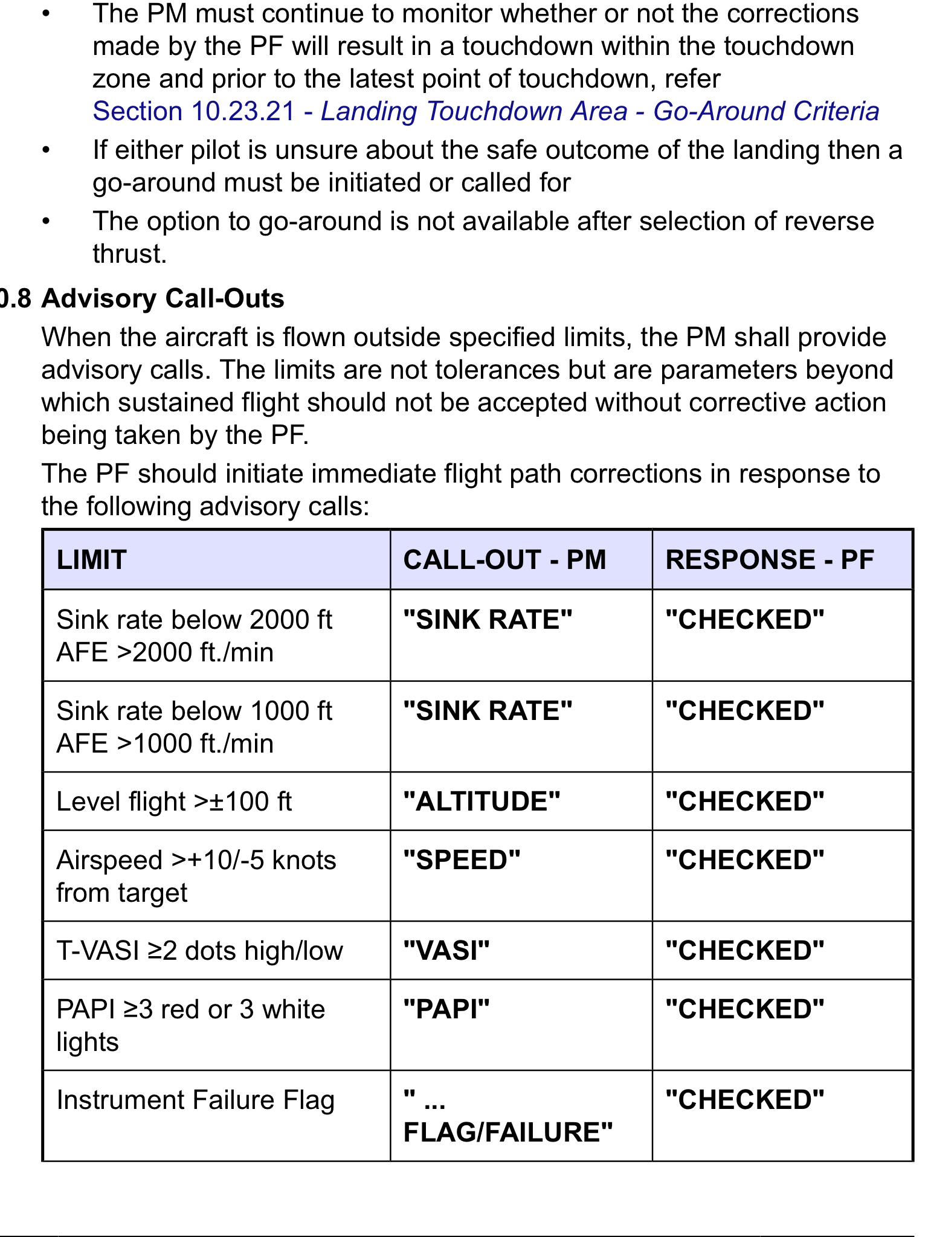
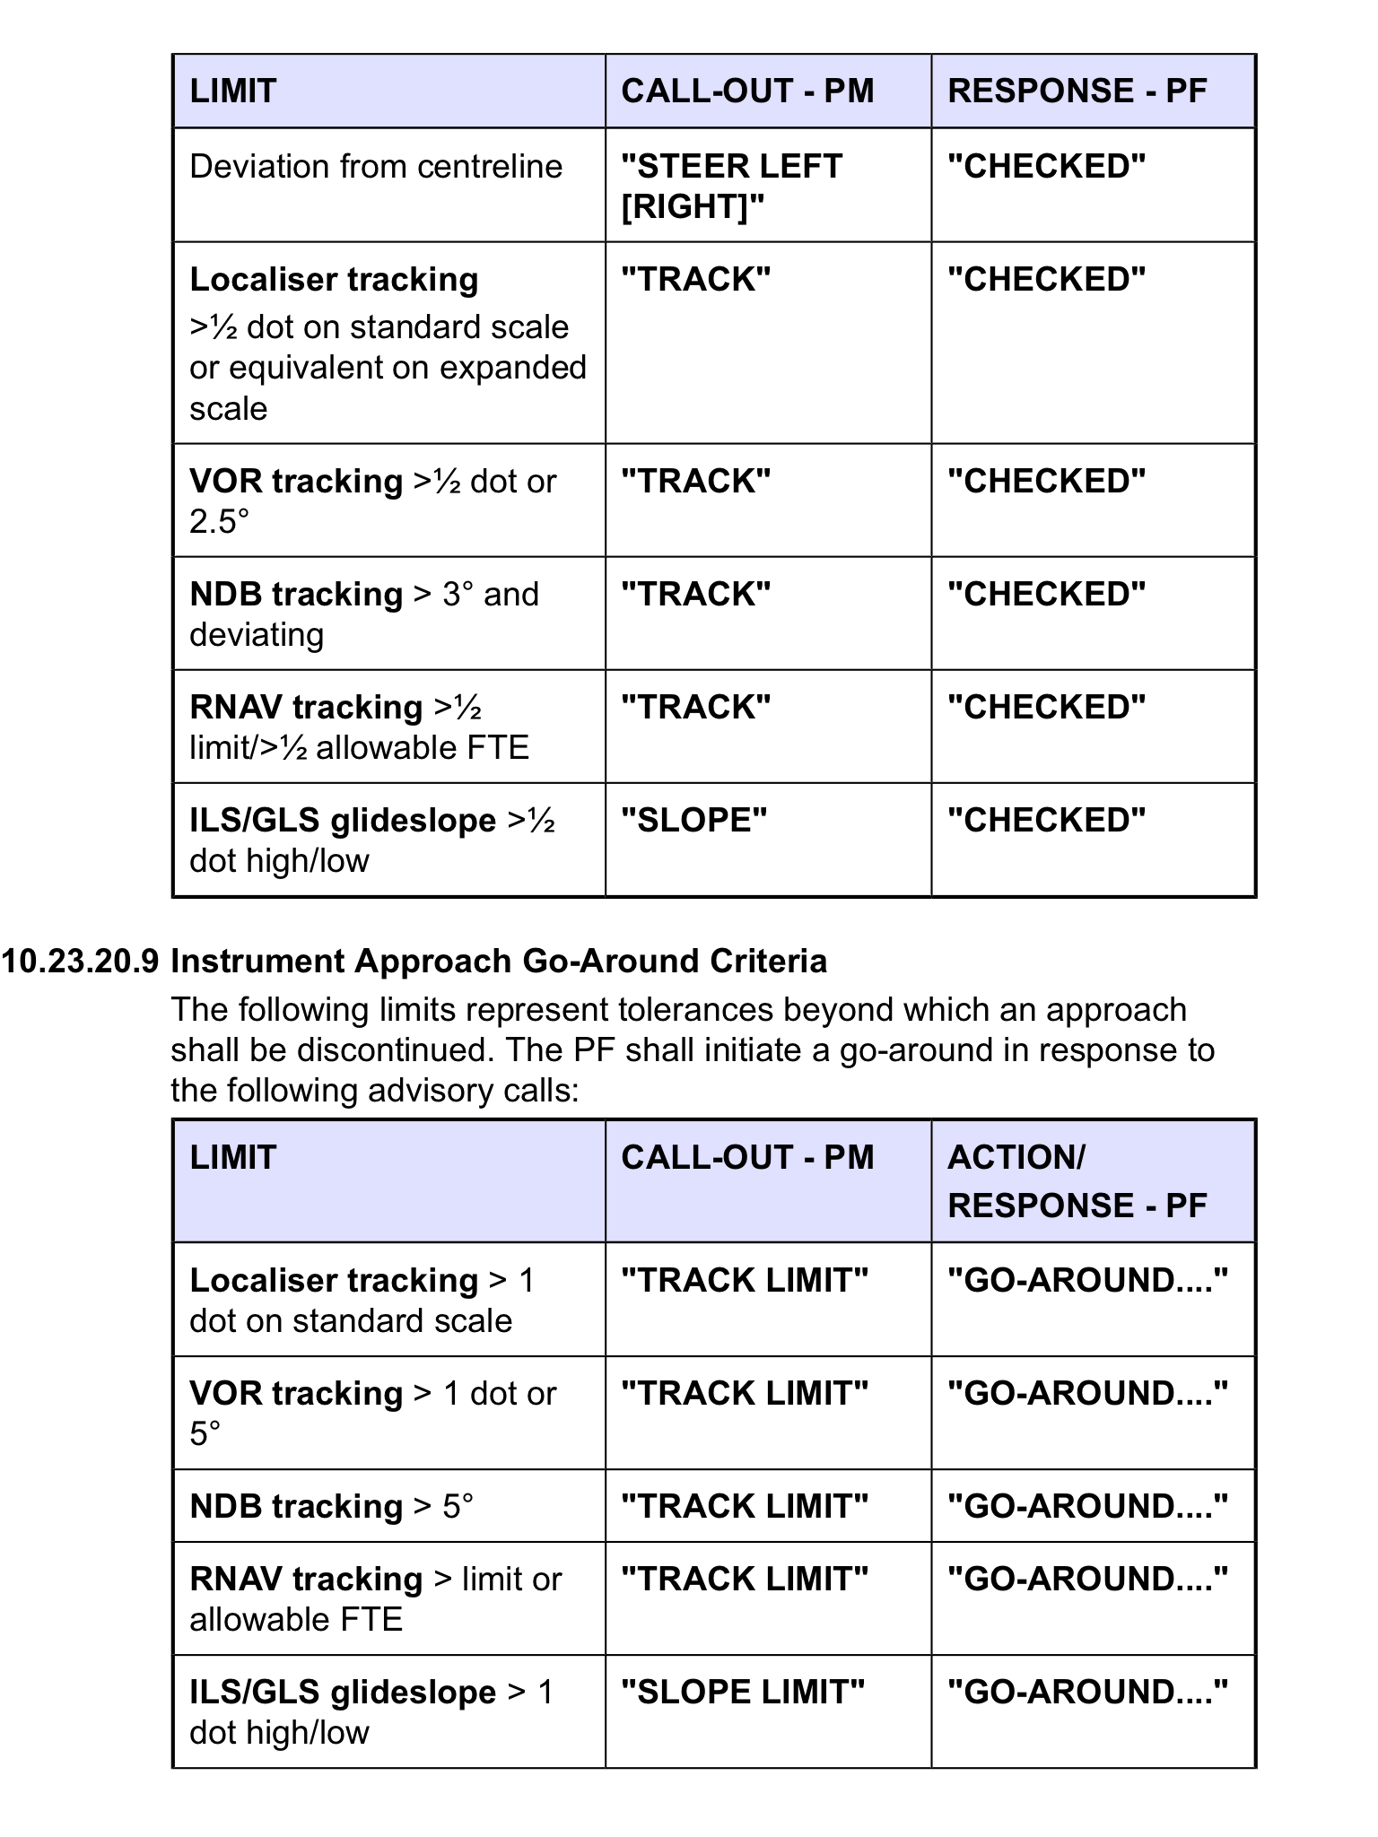
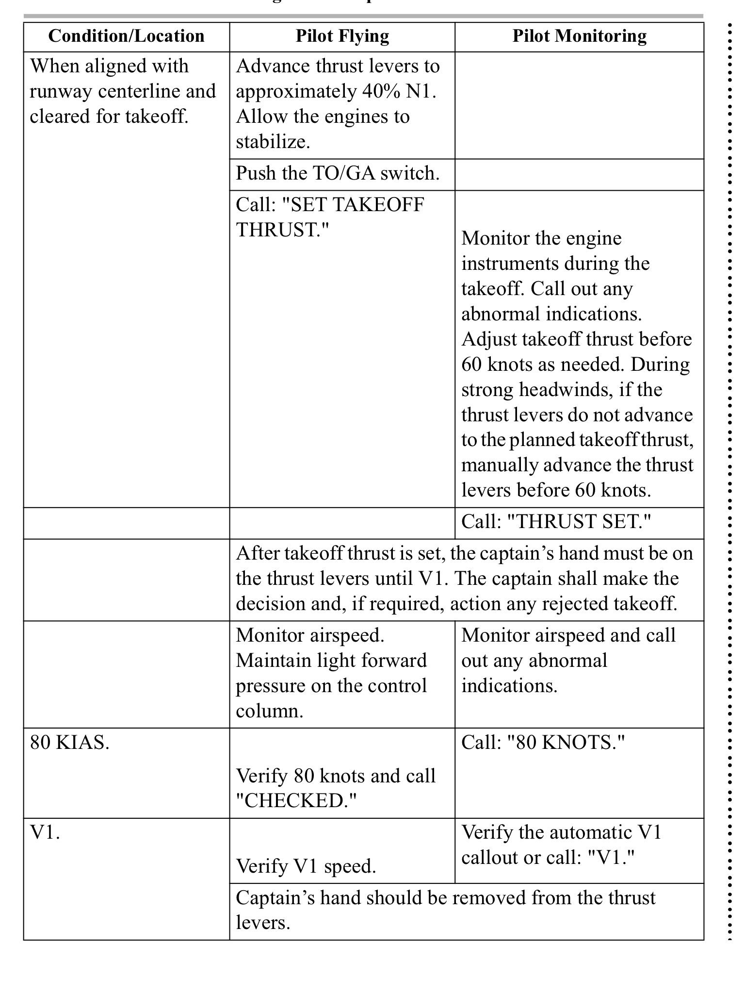
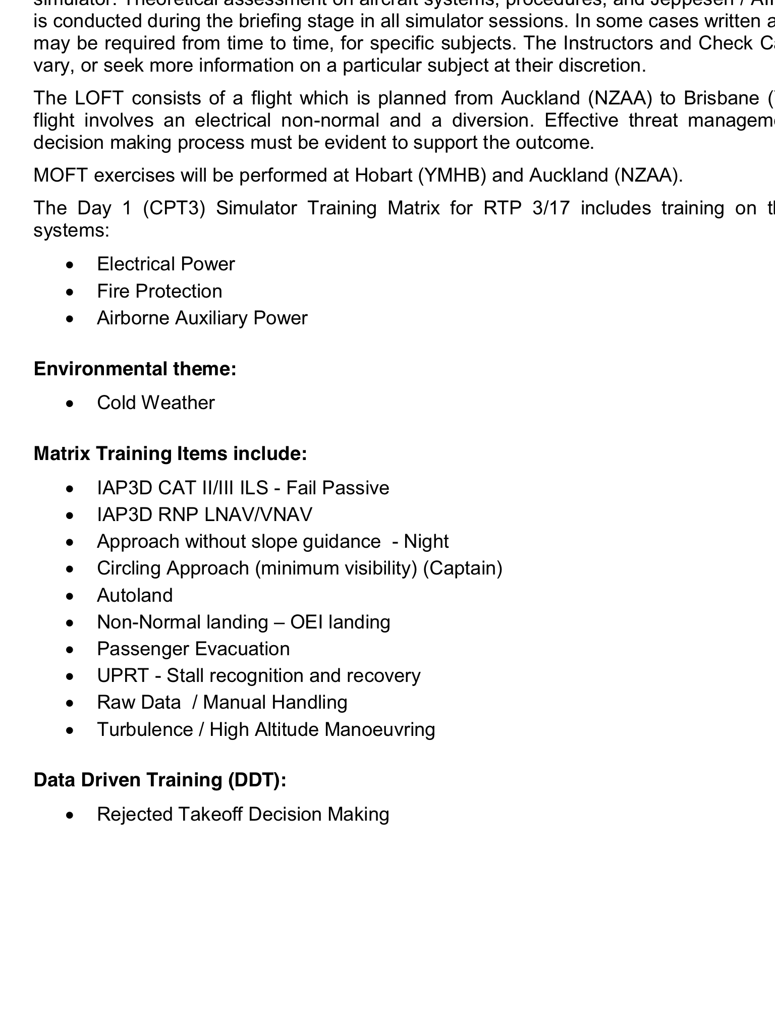

Slide 14
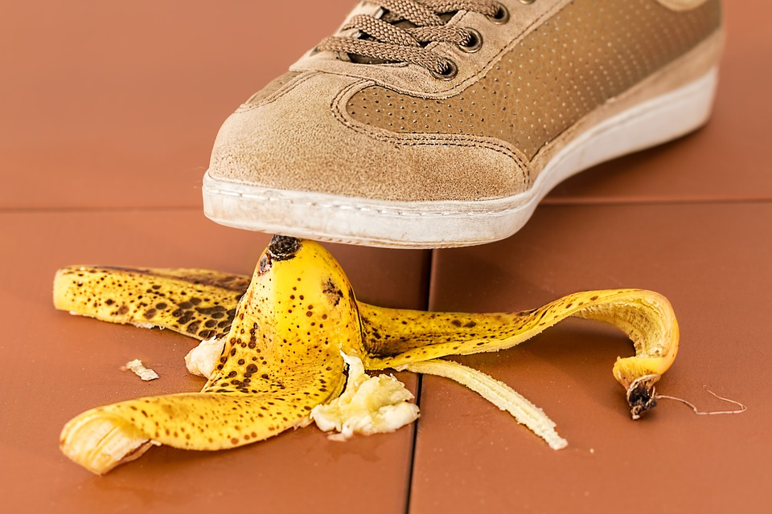
Time for a leap of faith…..

Slide 15
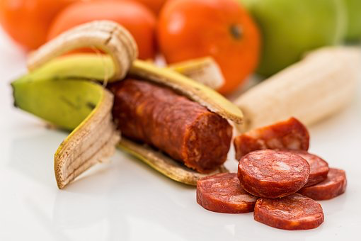

Slide 16
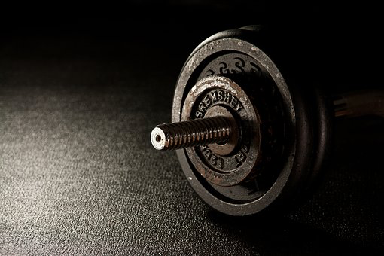
NTS Workout Training
Schedule
Zero Jeopardy
No pass or fail
Focus is NON Technical Core elements
Trainers trained appropriately

Slide 17
NTS Workout Training
Schedule
Consult with NTS specialists
Trainers to debrief appropriately
New research excercised
Results shared within the global community

Slide 18
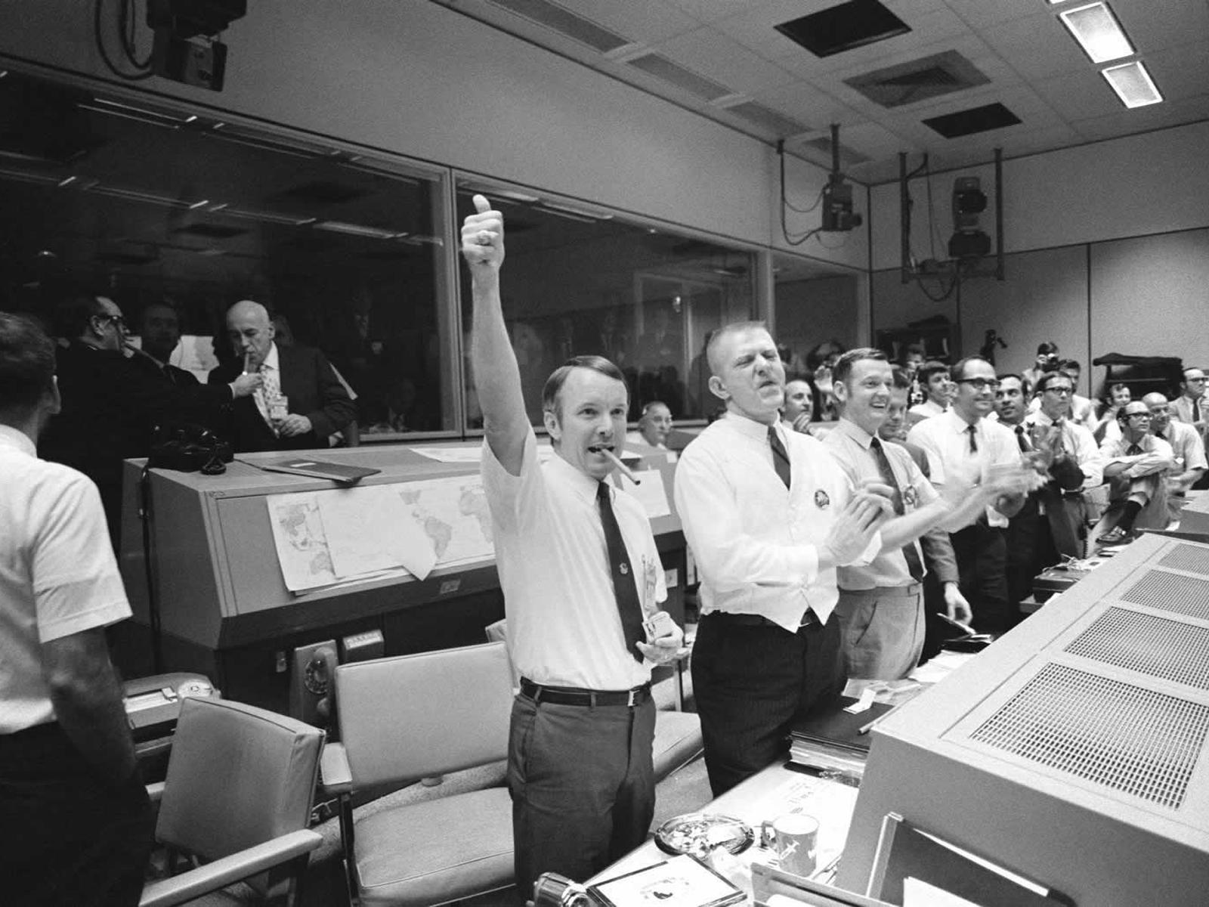
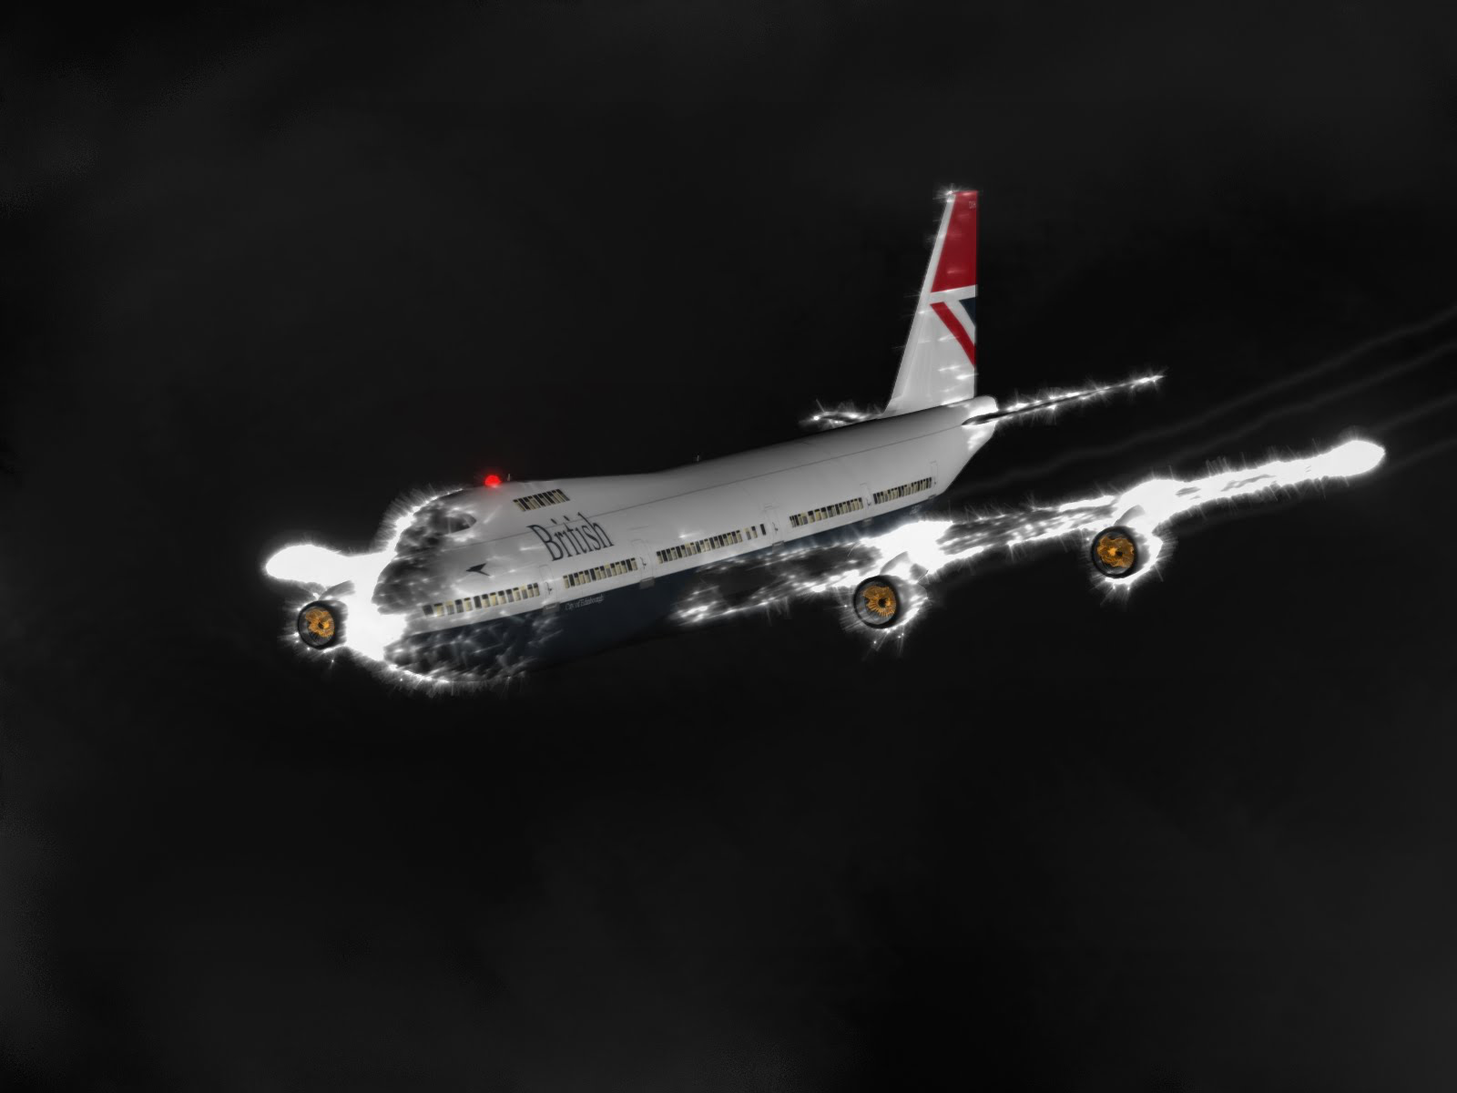
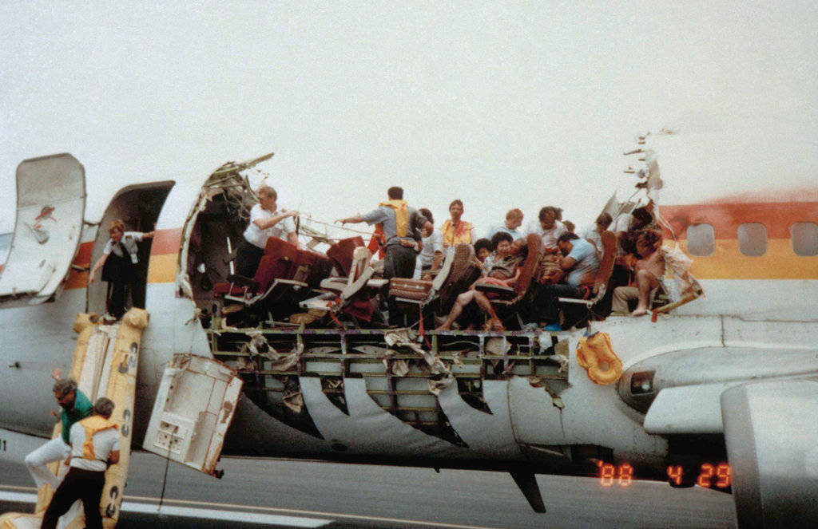
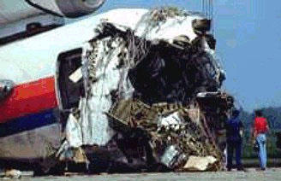
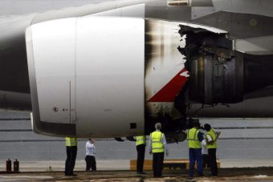
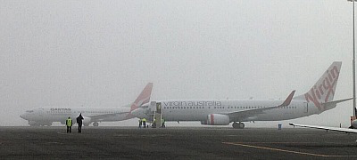
Apollo 13 Earth moon 1970
BA 009 Jakarta 1982
Aloha 243 Hawaii 1988
Sioux City DC-10 1989
Cactus 1549
QF32 Singapore 2010
VA 1384 Mildura 2013

Slide 19
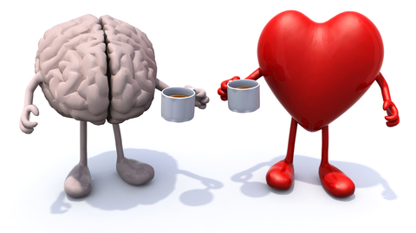
Time for a break……

