Slide 1
Team Resource Management PACDEFF 2010
Bill Appleby

Slide 2
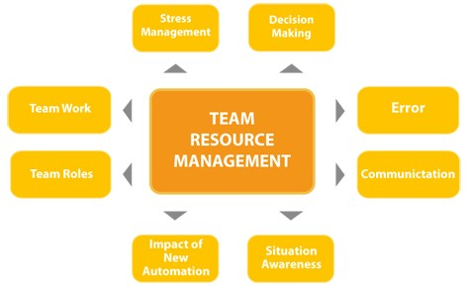
History
Came to New Zealand in June 2005 via Rien Doorne and Dr Anne Isaacs
Rien and Anne trained 8 facilitators, we now have 7
Facilitators must maintain operational currency as controllers
Courses were 3 days long and for Air Traffic Controllers and Flight Service only
Attendance was voluntary or as directed by Team Leaders

Slide 3
Evolution
Initial TRM course is now 2 days
Introduced a 1 day refresher course in mid 2010
TRM was made compulsory for Operational staff from mid 2010
Human Factors training was made compulsory as part of the Initial ATC training programme from mid 2010
New Operational staff must complete the initial 2 day TRM course within 2 years of gaining their initial rating
Operational staff must complete a 1 day refresher course every 2 years
Facilitators meet 6 times per year for module review and development
We train new Facilitators and develop new modules ‘in-house’

Slide 4
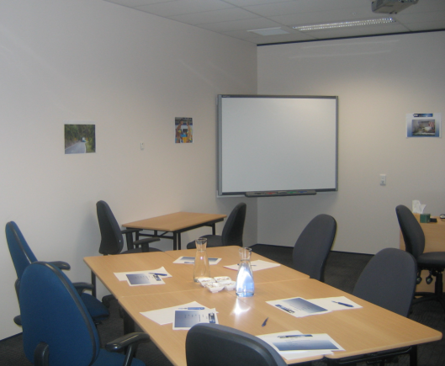
TRM Course Environment
Informal room layout – ‘coffee table’ groups rather than classroom desks
5 to 12 participants per course with 10 being ideal
Facilitate discussions of situations and experiences
Minimal ‘teaching’ by facilitators although a small amount is necessary when attendees have not completed HF and Stress courses
Use Case Studies
Sub-group discussions and exercises
Encourage participation in demonstrations
Use a variety of short videos
Sub-group reporting either to whole course or by using ‘ambassadors’
Record the ‘most important aspects’ at the end of each module for inclusion in course notes
Course Folders notes are not given out until the end of the course, but blank paper and pens are available from the start

Slide 5
TRM Course Content

Slide 6
TRM Objectives
To reduce and minimise the impact of teamwork related errors
To develop more positive attitudes and behaviour towards teamwork skills and human performance
To enhance safety

Slide 7
TRM is…..
A way to enhance safety
A way to reduce errors
A way of changing thinking and acting
About attitudes and behaviours
An opportunity to contribute to team performance
About people
Sometimes we explain what TRM is NOT as well

Slide 8
What TRM Training Covers
Initial Two Day Course
Human Information Processing
Communication
Stress
Decision Making
Situational Awareness
Threat and Error Management
Team Working
One Day Refresher Course
Technology/Change Management
Threats and Errors
‘Hot Topics’ – areas of ‘interest’ noted by the Safety Team

Slide 9
Facilitation
Is a new concept to most people so we explain :
We make it easy for the group to have a discussion - Auctioneers?
We use videos, case studies (incidents), exercises, sub groups and general discussion
Sometimes we give a little information during a module, more to stimulate thought than to impart knowledge
We explain that the knowledge and experience you bring is where the gold is, that it is very important and where we learn the most
We are the timekeepers, important if you want “morning tea and lunch”
Like referees, we start and stop the game - and whistle at the end of day
Mostly we have time for discussions to conclude but we may sometimes need to move on
There is no need for note taking as a folder with notes will be available at the end of course

Slide 10
Videos
Short videos are used to:
Introduce a topic
Reinforce a point
Summarise a module
Provoke thought
Entertain
The example chosen:
Is shown at the end of our Stress module
Demonstrates aspects that are relevant to all of the modules:
HIP, Stress, Communication, Situational Awareness, Decision Making, Error Management and Team Working

Slide 12
Challenges and Solutions
Management and Team Leadership ‘buy in’
Presentation to CEO and Executive Managers
Instead of being just a Training Centre course, TRM was ‘adopted’ by the Safety Team.
Led to TRM training being made compulsory for Operational staff (Air Traffic Controllers and Flight Service)
Cost centre Managers needing to justify costs associated with TRM training
Managers/Team Leaders wanting evidence that TRM is ‘working’ and is worth the significant resource being put in

Slide 13
The Future ……..
Near future
Hope to see TRM extended to include:
Policy and Standards Specialists
Non Operational Line Managers
Technical and System Specialists
Operational Software Specialists
More distant
Hope to see the inclusion of other staff:
All other Managers including CEO and Executive
All other company groups ie Human Resources and Finance
All other support staff ie Admin, Reception

Slide 14
Any Questions?

